Slide 1
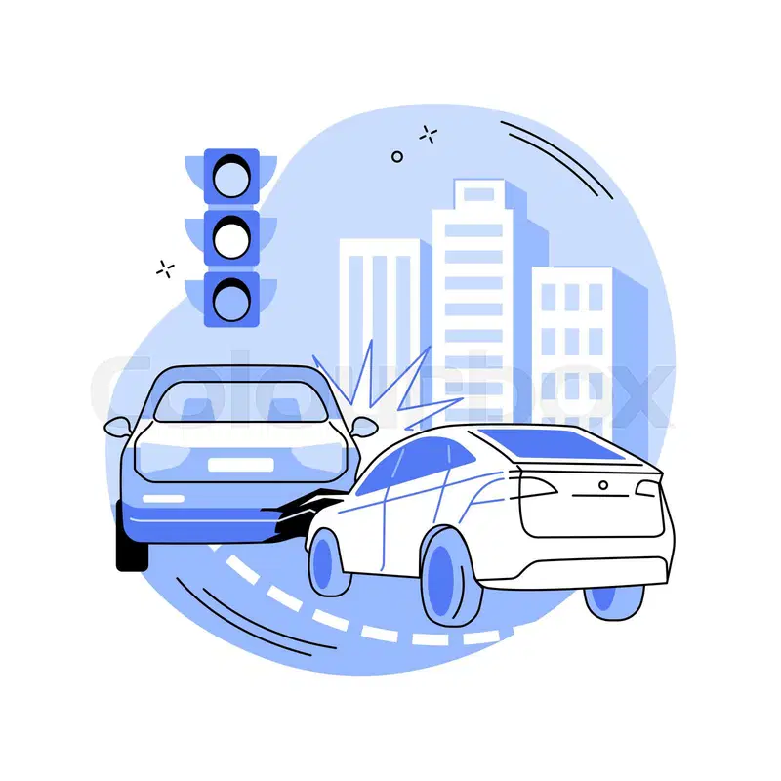
BEYOND THE
CRASH
A Look into U.S. Road Accidents
Duaa Mohamed Salman

Slide 2
PROBLEM STATEMENT
Transportation and safety authorities seek to understand the factors contributing to the increasing number of car accidents and to identify areas of weakness in current road safety strategies. This study aims to identify and evaluate key factors behind road accidents in order to:
Guide strategic actions based on analytical findings
Reduce accident
rates
Improve public
safety

Slide 3
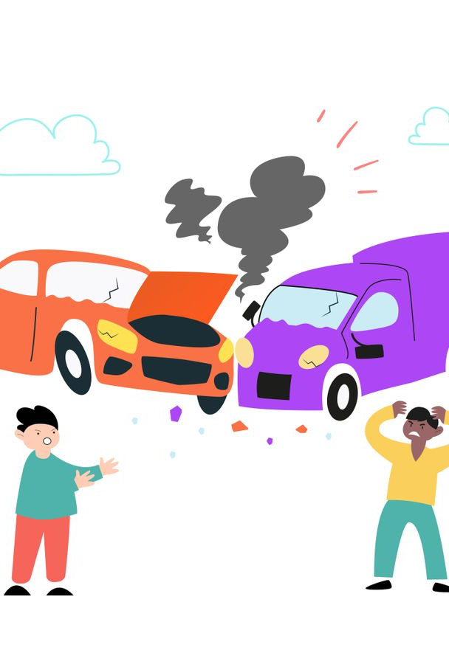
DATA OVERVIEW
years 2019 to 2022
Accident
7 m
Contry
US
CITIES
11488

Slide 4

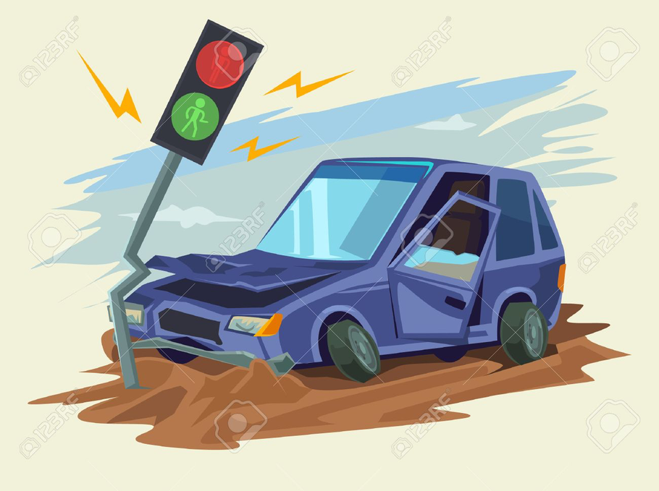


OBJECTIVE
Accident Trends Over Time:
Analyze how accident rates have changed throughout the years and identify which days experience the highest number of accidents.
Day vs. Night Comparison:
Examine differences in accident frequency between daytime and nighttime periods.
Geographical Distribution:
Identify U.S. cities with the highest accident counts and assess
Environmental and Contextual Factors:
Evaluate how weather conditions and points of interest (POI) influence accident frequency.

Slide 5

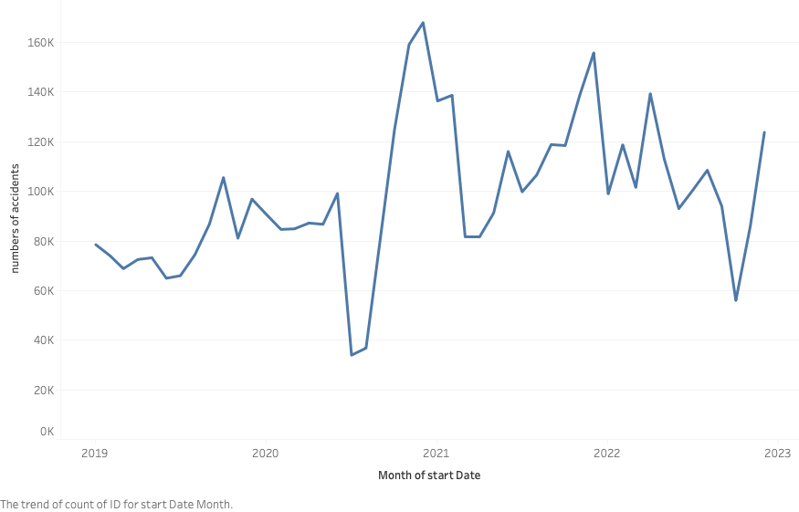
ACCIDENTS OVER THE YEARS

Slide 6



EXTERNAL FACTORS INFLUENCING ACCIDENT PATTERNS (2020–2021)
Early 2020 – COVID-19 Outbreak Begins
2021 – Biden Administration Policies
2021 – Extreme Weather Events
The pandemic starts spreading across the U.S., leading to lockdowns, reduced mobility, and fewer vehicles on the road Travel bans, school closures, and work-from-home policies cause a sharp drop in traffic accidents..
New regulations reverse several travel and environmental restrictions, increasing national mobility.
Severe storms in Texas and record heat waves in western states affect road conditions and accident rates.

Slide 7
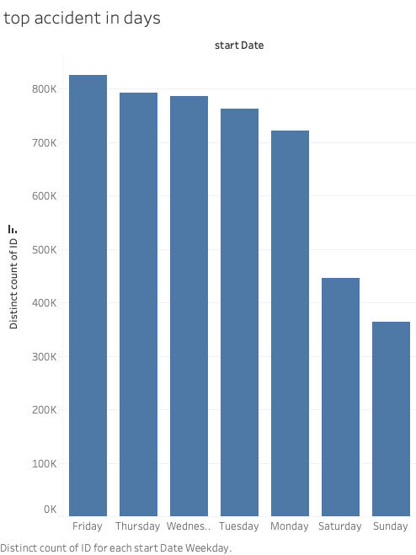

TOP ACCIDENT IN DAYS
STATISTIC
Number of accidents
Thynk Unlimited

Slide 8
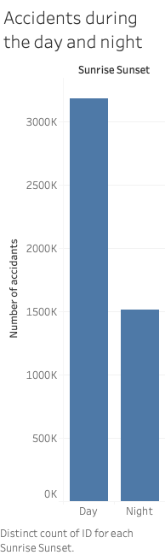
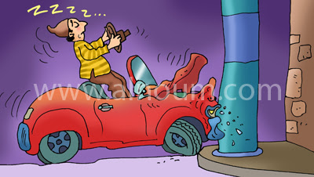
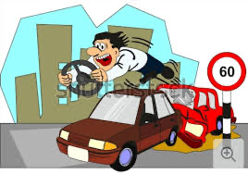
DAY VS. NIGHT ACCIDENT.
Thynk Unlimited

Slide 9
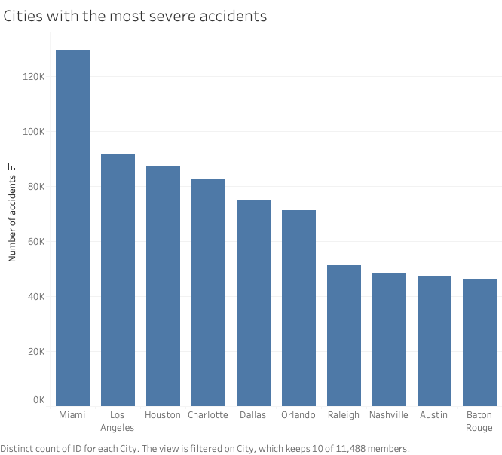
US CITIES WITH THE HIGHEST NUMBER OF ACCIDENTS
Number of accidents
Accidents are most frequent in Miami , Los Angeles and Houston .
Thynk Unlimited
cities

Slide 10

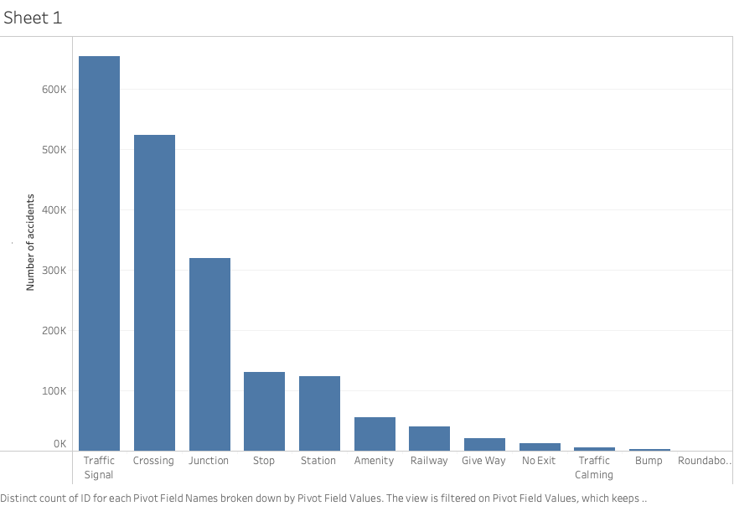



POINT OF INTEREST ANNOTATION
Number of accidents
Thynk Unlimited
Point of interest annotation

Slide 11

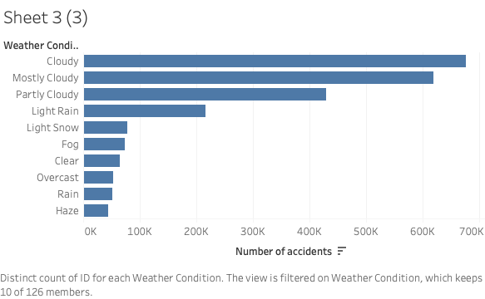


WHATHER CONDITION

Slide 12


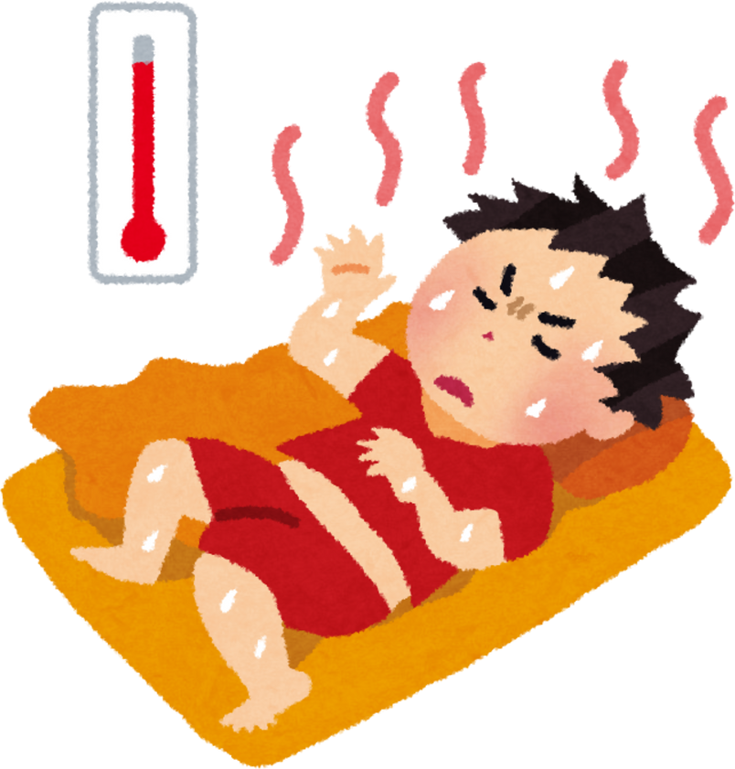
ENVIRONMENTAL
FACTORS

Slide 13
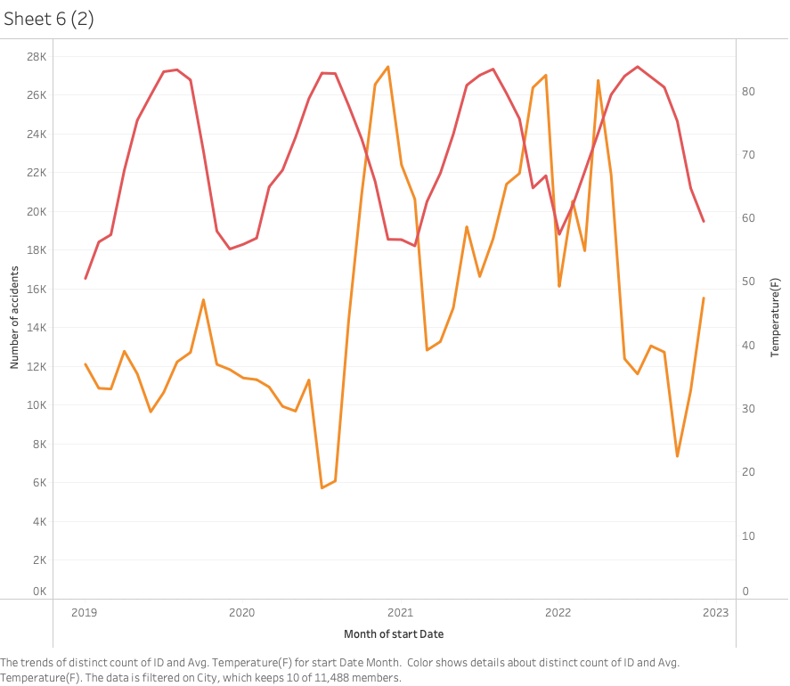
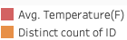
TEMPERATURE(F)
A rise in temperature (red line) corresponds to a decrease in the number of accidents (orange line).
A fall in temperature (red line) corresponds to a rise in the number of accidents (orange line).

Slide 14
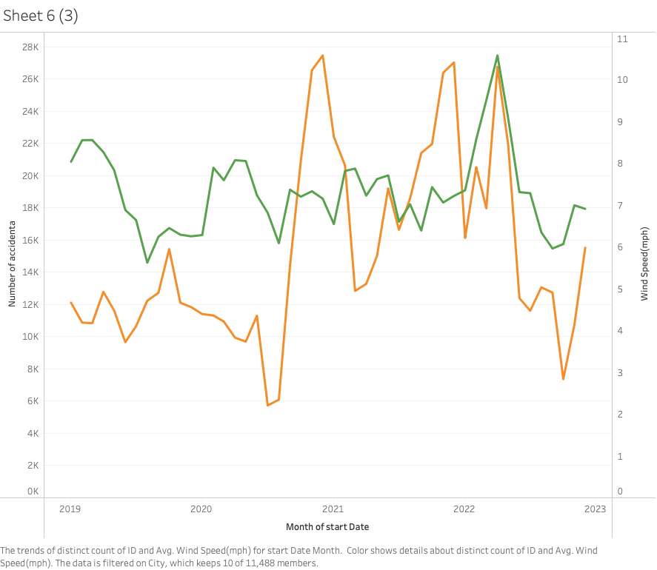
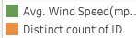
WIND SPEED(MPH)
(Strong Winds):
Reduces the number of accidents, perhaps by reducing traffic or increasing driver caution.
(Low Winds):
Increases the likelihood of a large number of accidents.

Slide 15
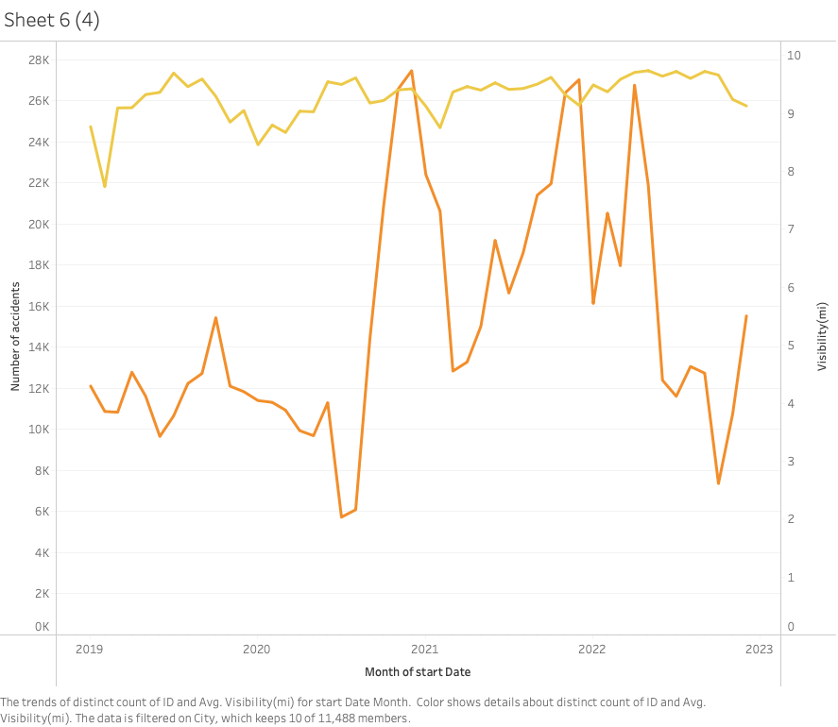
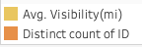
VISIBILITY(MI)
Visibility remains very high (near 9-10 miles) most of the time. This suggests that while very low visibility (below 8 miles) may contribute to accidents, other factors (e.g., traffic volume, road conditions) are likely the main drivers of accident fluctuations.

Slide 16



ENVIRONMENTAL FACTORS FROM MOST TO LEAST INFLUENTIAL ON THE NUMBER OF ACCIDENTS
Temperature
Clear Inverse
Strong Inverse
Wind Speed
Directly explains major seasonal fluctuations; colder weather (winter) drives accident spikes due to hazardous road conditions
Low wind speeds (calm weather) correlate with accident peaks; high winds might discourage traffic or increase caution
Visibility
Weak/Limited Inverse
Only contributes when visibility drops to critical levels (below 8 miles); generally not the primary driver.

Slide 17
RECOMMENDATON
Public Safety Officials
Vehicle Manufacturers
The General Public
Adopt Cold Weather Driving Caution.
Be Extra Vigilant During Peak Commute Times.
Maintain Safe Distance in Calm (Low-Wind) Conditions.
Prioritize Winter Weather Preparedness.
Target Enforcement on Fridays and During Daytime.
Upgrade High-Accident Intersections.
Enhance Winter Traction and Stability Systems.
Improve Low-Visibility Lighting and Defrosting.
Integrate Low Temperature Driver Alerts.

Slide 18

THANK YOU
FOR YOUR ATTENTION

